Slide 1
Dimensionality Reduction in Machine Learning
with PCA
Sercan Gul - Data Scientist

Slide 2
Why do we need to reduce dimensionality?
In some cases, we have too many features, which might create multicollinearity or computing inefficiencies
More features = more training time
More features = more memory usage (limiting computing resources)
Dimensionality reduction is needed:
to find key features in the data
to improve computation efficiency
to improve model performance

Slide 3
Principal Component Analysis
Orthogonal Transformation
Convert a set of observations into a set of linearly uncorrelated variables known as principal components
The number of principal components (p) available are min (n-1,m)
Limited by variables/features, m, and the number of data, n
Components are ordered
First component describes the largest possible variance / accounts for as much variability as possible
Next component describes the largest possible remaining variances
Up to the maximum number of principal components

Slide 4
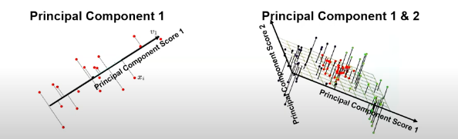
Principle Components
The line in 1D that best describes the data The plane in 2D that best describes the data

Slide 5
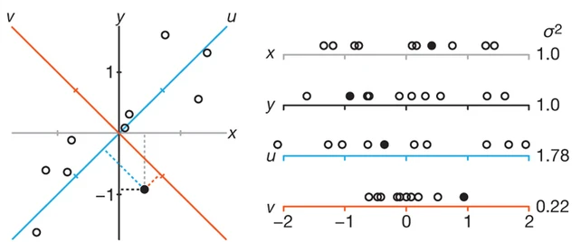
A visual representation in 2D data
Start with regular 2D data with x and y coordinates below:
See the projections on to x and y axes. Data has equal variance in x and y (total variance = 2.0)
Find the rotation that would maximize the variance on the projection, u (one dimension, with variance = 1.78)

Slide 6
Calculation of Principal Components
Standardize the features
Calculate the standardized feature covariance matrix
Calculate eigenvalues and eigenvectors of the covariance matrix
The eigenvectors of the data covariance matrix are the principal components
The eigenvalues are the variance explained for each component
Note: We won’t be able to go through all the equations here, this will be demonstrated in the python study session.

Slide 7
Assumptions
Large enough sample set for reliable correlation calculations
n = 5 x m and n> 150
variables/features, m, and the number of data, n
There is correlation between the features
Outliers are addressed

Slide 8
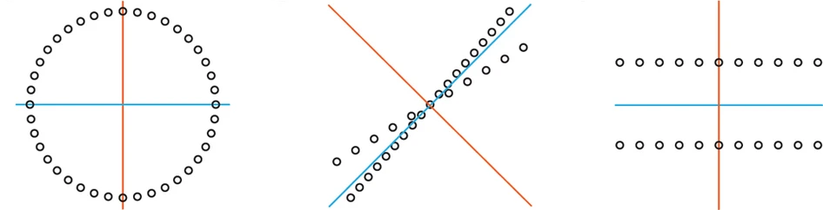
PCA will not perform well if:
Non linear patterns Nonorthogonal Patterns Obscure Patterns

Slide 9
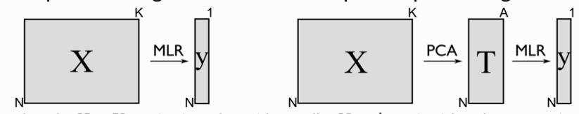
What can you do with PCA?
Prediction:
Reduce dimensions, build a model with the principal component scores and then restore to estimate the data values.
PCA regression: regression on the most important principal components
Inference:
Understand our variables and how variance is partitioned
Check for and mitigate multicollinearity
Exclude principal components that have low variance

Slide 10
Python How To
See Principal Component Analysis.ipynb notebook file for more details
Required packages:
Python 3.9
Sklearn, pandas, numpy, matplotlib

